Slide 1



Scheduling Algorithm Research.
Prototype a range of proposed scheduling algorithm improvements with dummy data
Iteration 1
Presenter: David Long

Slide 2
Overview
Literature Review and Method Selection
Initial Simple Dataset
Best Improvement Neighbourhood Search
Extended Heavy Maintenance Dataset
Introducing Random Sampling Method for Heavy Dataset
Behaviour of Algorithm
Future Works

Slide 3
Literature Review and Method Selection
Mathematical Programming
Stochastic Simulation
Metaheuristic Algorithms
Selected approach: Simulated Annealing with Variable Neighbourhood Search (SAVNS) (Winata, 2011)

Slide 4

Initial Dataset
Simple Dataset provided by Tim
10-aircraft fleet maintenance schedule
8 maintenance event with each even lasting 60 days
Maintenance windows constrained to 320–380 days
Initial random schedule caused heavy maintenance overlap
Goal: stagger maintenance checks to maximum of 2 aircraft offline

Slide 5


Best-Improvement Neighbourhood Search

Slide 6


Extended Heavy maintenance dataset
Maintenance Cycle: A → B → A → C → A → B → A → D
Minimum forecast length: 12 years
Represents 1.5 maintenance cycles
24 Aircraft having 11-12 maintenance events per forecast

Slide 7
Optimised Heavy dataset using Random Sampling
Initial neighbourhood search worked on smaller dataset but too slow for heavy dataset
Scaling to 24 aircraft made the search generate over 1000 schedules per iteration
Random sampling strategy introduced
Only 200 neighbouring schedules are evaluated which is sufficient to identify better local solutions.

Slide 8

Optimised Heavy maintenance dataset
Original
Min Availability: 15
Availability S.D.: 1.947
Average Availability: 21.694
Optimised
Min Availability: 18
Availability S.D.: 1.433
Average Availability: 21.712

Slide 9
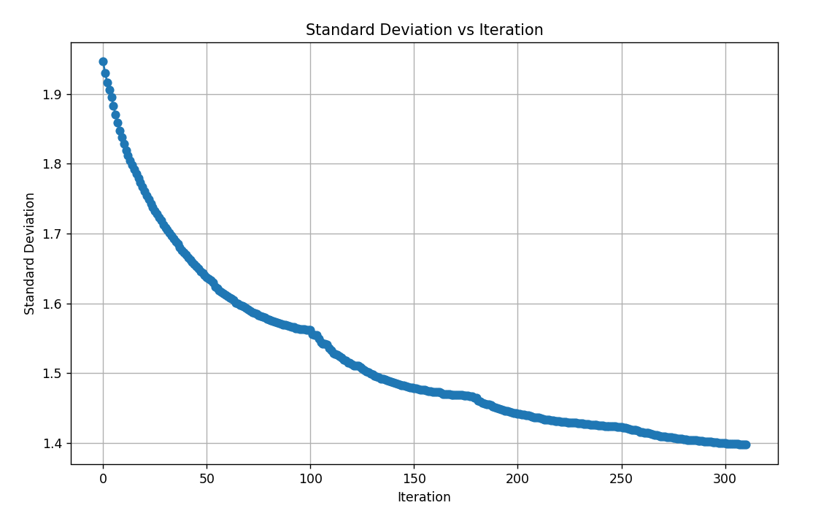
Convergence Behaviour of Variable Neighbourhood Search
Standard Deviation of fleet availability decreases over iterations
Final value converges to ~1.40
Around iteration ~100, the algorithm transitions between shift sizes
Earlier iterations relied on large shift sizes (±28)
Later iterations focused on local optimisation (±14, ±7, ±3)
Algorithm terminated at iteration 311 (no improvement found)

Slide 10
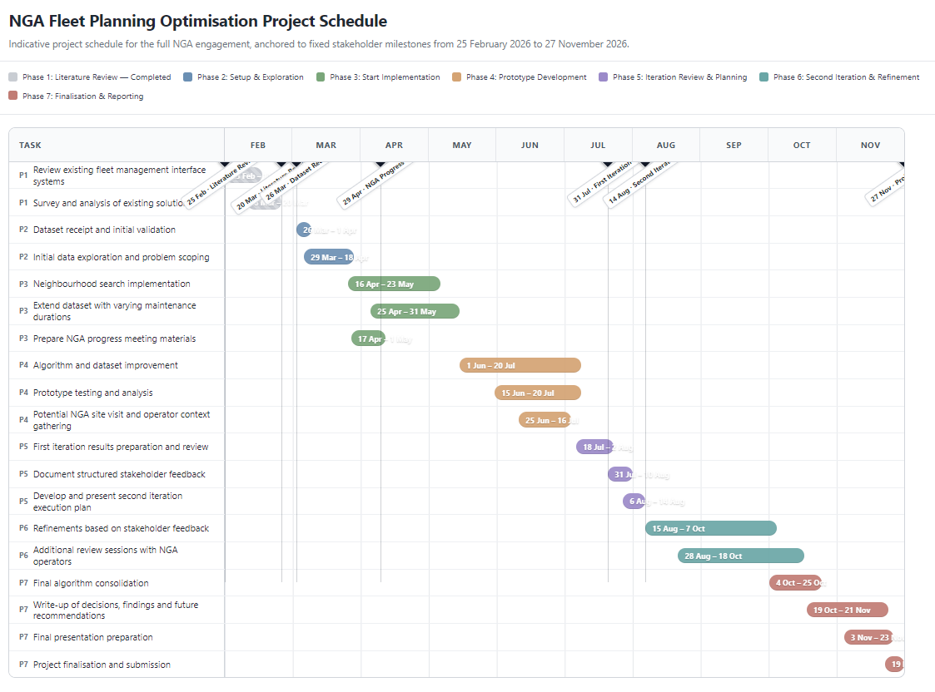
Future Work and Research Direction
Semester 2 (Iteration 2)
Investigate Simulated Annealing + VNS hybrid optimisation
Include additional operational and logistic constraints (in these 3 months, maximise availability, can change surrounding) (standard deviation inside the window)
Improve computational efficiency
Analysis of Hyperparameters
Look at the start to see if initial stagger changes outcome
Exploit left to right nature of timeline (start from left)

Slide 11
References
Pippin, Bradley W. Allocating Flight Hours to Army Helicopters. PhD thesis, Naval Postgraduate School, 1998.
U.S. Army, Black Hawk helicopter celebrates 40 years of aviation service with the Army, 2018.
Winata, Leonard. Heuristic approaches for flight and maintenance planning of Large Fleets. Doctor of Philosophy Thesis, RMIT University, 2011.

